Slide 1
COMP 3100
Week 6 - Monday

Slide 2
Last time
What did we talk about last time?
Software quality assurance

Slide 3
Questions?

Slide 4
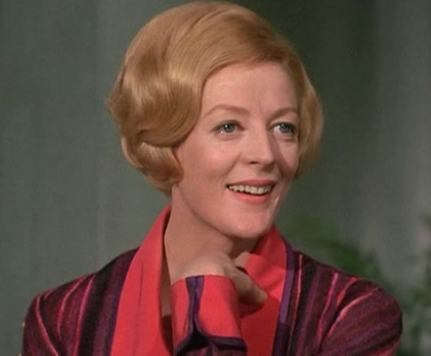

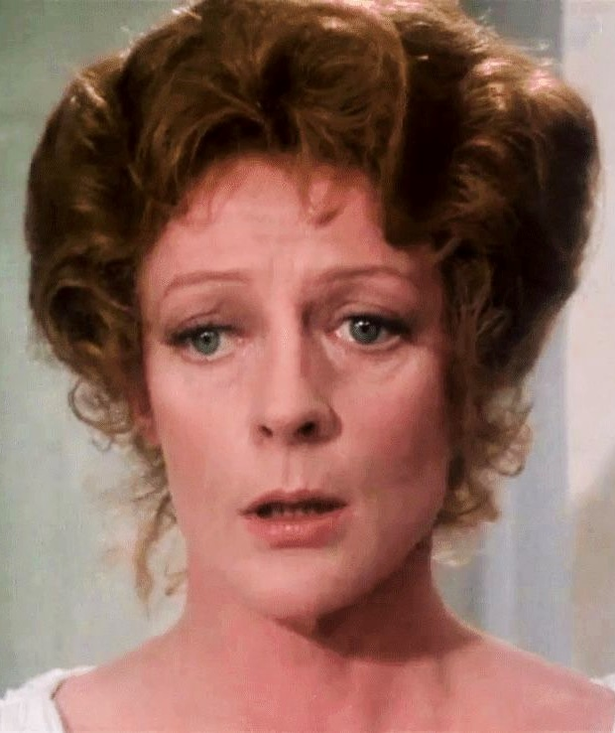

Maggie Smith 1934 - 2024

Slide 5
User Interaction Design

Slide 6
Interaction design
Interaction design is planning out the user experience (UX) for a software product
It cares about how the product looks and sounds (and, one day, smells?) and how the user gets output and puts input into it
This field used to get little attention from computer scientists, but it's really important
  Apple is a great posterchild for showing off the value of UX
  Even Microsoft, maligned for its user interfaces, has invested lots of money studying how to make windows and icons easier to use
UX is part of the field of human computer interaction (HCI), which combines ergonomics, physiology, psychology, and graphic design with computer science
The quality of a user interface is called its usability

Slide 7
User interaction design goals
Effectiveness: User can access all the features they need
Efficiency: Users can achieve their goals quickly
Safety: Users and computers aren't harmed
Learnability: Users become proficient quickly
Memorability: Users regain proficiency quickly after time away from the product
Enjoyability: Users experience positive emotions when using the product
Beauty: Users find the product aesthetically pleasing

Slide 8
Blackboard: A case study in terrible UX
Effectiveness: Content isn't easily viewable on phones, and some rows at the bottom or columns on the right can't be clicked on, depending on screen size
Efficiency: It takes something like 7 mouse clicks for me to upload a project feedback form
Safety: My wrists hurts after 7 clicks × 24 students
Learnability: There are features of Blackboard that students never learn about, and issues like the collapsing navigation bar cause perennial problems
Memorability: All the different options for exam timing and turn-in options seem just as confusing each semester
Enjoyability: I want to kill everyone after using Blackboard
Beauty: This one is subjective, and I will admit that it looks better than it did 10 years ago

Slide 9
When to do interaction design
In the past, people were concerned with the computation and threw in UX as an afterthought
Now, we realize that UX has a lot to do with the features the product should have
Interaction design should be a key part of requirements specification
Some agile people think you should do the interaction design during one sprint for the features that will be implemented in the next sprint

Slide 10
Interaction design models
Before coding the UX, models are incredibly helpful to plan out how it looks and behaves
Static interaction design models show the audio and visual parts of the product that don't change during execution
Dynamic interaction design models show behavior during execution
Both are useful

Slide 11
Use case diagrams
A use case is an interaction between a product and its environment
An actor is an agent that interacts with a product
Use case diagrams (which we've seen before) are static interaction design models that represent the actors that interact with use cases

Slide 12
Layout diagrams
Screen layout diagrams and page layout diagrams are drawings of a product's visual display
A wireframe is a low-fidelity version that gives a rough layout without a lot of detail
It's good to start with a wireframe and refine it with more detail later

Slide 13
Use case descriptions
A use case diagram shows which actors interact with use cases
However, it doesn't explain what they do
A use case description is formatted text that explains the actions that an actor makes
The use case description is a dynamic interaction design model
Example template:
Use Case Name | To identify the use case
Actors | The agents participating in the use case
Stakeholders and Needs | What this use case does to meet stakeholder needs
Preconditions | What must be true before this use case begins
Post conditions | What will be true when this use case ends
Trigger | The event that causes this use case to begin
Basic Flow | The steps in a typical successful instance of this use case
Extensions | The steps in alternative instances of this use case due to variations in normal flow or errors

Slide 14
Storyboards
Another dynamic interaction design model is a storyboard
A storyboard shows different screen layout diagrams connected with arrows
  The arrows show either the passage of time or responses to events
Use case descriptions can describe what is happening in interactions, but storyboards show what it looks like
Like screen layout diagrams, they will usually start simple and then become more detailed

Slide 15
Use case models and requirements
Use case models can be helpful at the requirements stage
Even with use case descriptions, they don't give enough information about requirements that are not connected to interactions
  Like processing the data once it's been received
  Or non-functional requirements
They're good at showing interactions but not necessarily how to build the system that makes those interactions work
In short, use case models are useful but not enough
Use case models can help elaborate PBIs during sprints

Slide 16
Interaction design processes
Interaction design should move from abstract models to more concrete, refined ones
From stakeholder needs, you can make a use case diagram
These can be elaborated with use case descriptions
Screen layout diagrams and storyboards help with design and getting feedback
Usability testing uses experiments with test subjects to see if they can interact with the product
  Testing doesn't have to be on the full, polished product
  Measurement could be:
    Asking the subjects questions about their experience
    Counting their errors
    Measuring time taken to accomplish tasks

Slide 17
Crash Course on Java Swing

Slide 18
JOptionPane

Slide 19
JOptionPane
JOptionPane class provides static methods for:
  Displaying a message
  Asking a question
Although it is possible to create a JOptionPane object, you almost never do
Just call the static methods
  Which means typing a lot of JOptionPane.

Slide 20
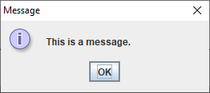
showMessageDialog() example
To display "This is a message." you could call the following:
JOptionPane.showMessageDialog(null,
"This is a message.");

Slide 21
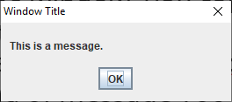
Adding a title
Most JOptionPane methods have many overloads
If you want to put a title on the window, you can pass it in as the third parameter
But this overloaded method also requires an int parameter that says what kind of message you want
To add the title "Window Title", you might call the following method:
JOptionPane.showMessageDialog(null,
"This is a message.", "Window Title",
JOptionPane.PLAIN_MESSAGE);

Slide 22
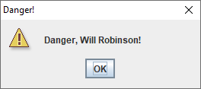
Different icons
You can choose an icon associated with one of the following constants:
  ERROR_MESSAGE
  INFORMATION_MESSAGE
  WARNING_MESSAGE
  QUESTION_MESSAGE
  PLAIN_MESSAGE
JOptionPane.showMessageDialog(null,
"Danger, Will Robinson!", "Danger!",
JOptionPane.WARNING_MESSAGE);

Slide 23
showConfirmDialog()
What if you don't just want to display a message?
You could also display a prompt with yes, no, and cancel buttons, using the following method signature
int showConfirmDialog(Component parent,
Object message)
This method will display message and return one of the following int constants inside JOptionPane:
  YES_OPTION
  NO_OPTION
  CANCEL_OPTION

Slide 24
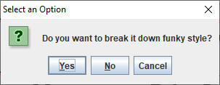
showConfirmDialog() example
int answer = JOptionPane.showConfirmDialog(null,
"Do you want to break it down funky style?");
if (answer == JOptionPane.YES_OPTION) {
JOptionPane.showMessageDialog(null, "Dope!");
} else {
JOptionPane.showMessageDialog(null, "Weak!");
}
Hitting the X in the corner is the same as Cancel

Slide 25
showInputDialog()
A more flexible option for input is showInputDialog()
It allows the user to type arbitrary text into a box
Be careful with the return value
  If they cancel, it's null
  They might put crazy spaces at the beginning and end (use trim())
  Numbers have to be converted from String values
Signature:
String showInputDialog(Component parent, Object message)

Slide 26
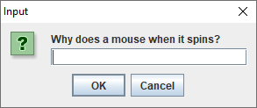
showInputDialog() example
This input dialog asks a pressing question
As with other methods, there are overloaded versions that allow for titles, icons, and other options
String answer = JOptionPane.showInputDialog(null,
"Why does a mouse when it spins?");

Slide 27
JFrame

Slide 28
JFrame
JOptionPane was fine for creating a limited range of dialogs
If we want to make a whole window, we use JFrame
Java uses the term frame instead of window, probably because of concerns about lawsuits from Microsoft
But when you hear JFrame, think "main window"

Slide 29
Creating or extending
When designing a JFrame, there are two meaningful options:
  Creating a JFrame object and adding stuff to it inside of some other class
  Extending JFrame with your own class, making your class a JFrame plus more
It doesn't really matter which one you pick
To keep things simple, we'll create a JFrame object instead of extending the JFrame class

Slide 30
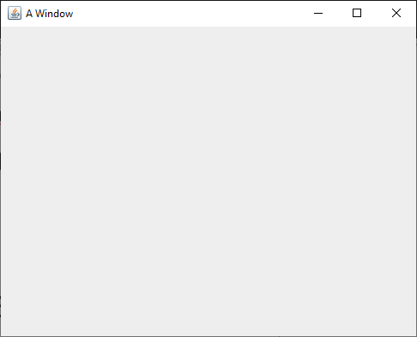
Creating a JFrame
To create a JFrame, we will usually call its constructor that takes a String, giving it a title
Then, we have to make it visible so that we can see it
JFrame frame = new JFrame("A Window");
frame.setVisible(true);

Slide 31
setSize()
The code from the previous slide will make a JFrame and make it visible
However, it will probably be so small that you won't even notice it
To deal with this problem, you should set its size, ideally before you make it visible
  Its setSize() method takes two int values: width and height in pixels
Eventually, once we add widgets to a JFrame, we can simply call its pack() method, which will make it take up the amount of space it needs to fit everything
JFrame frame = new JFrame("A Window");
frame.setSize(500, 400);
frame.setVisible(true);

Slide 32
setDefaultCloseOperation()
Next, you'll notice that closing the window doesn't end the program
  The little red square on the IntelliJ Console is still clickable, meaning that the program is running
By default, closing the window by clicking its X only hides the window
By calling the setDefaultCloseOperation(), we can make it so that the default operations is dispose (getting rid of the window)
Many books suggest passing in JFrame.EXIT_ON_CLOSE, but you should not!
Doing so will kill the rest of your program like System.exit()
JFrame frame = new JFrame("A Window");
frame.setSize(500, 400);
frame.setDefaultCloseOperation(JFrame.DISPOSE_ON_CLOSE);
frame.setVisible(true);

Slide 33
Widgets

Slide 34
Widgets
Widget is a generic term for a wide range of GUI controls
  Buttons
  Labels (allowing us to put text or images on a GUI)
  Text fields
  Text areas (like text fields but larger)
  Menus
  Checkboxes
  Radio buttons
  Lists
  Combo boxes
  Sliders

Slide 35
JButton
A button you can click on is provided by the JButton class
A JButton is usually created with text or an image
Just creating the JButton doesn't do anything
You have to add it to a JFrame (or other container) to see it
Right now, we're just creating the buttons
Later, we'll learn how to add actions to them
JButton button = new JButton("Push me!");

Slide 36
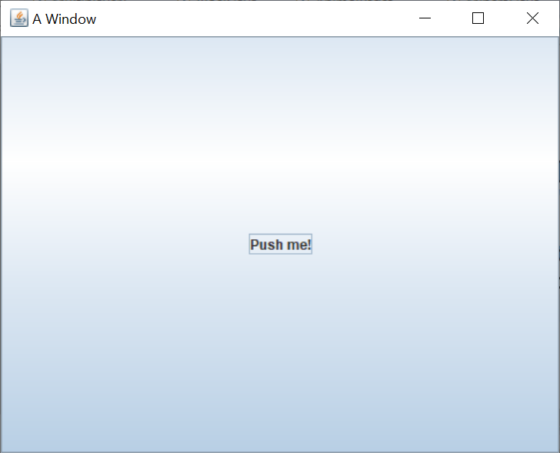
Adding a JButton to a JFrame
Once you've created a JButton, you can add it to a JFrame by calling the add() method on the JFrame
All GUI containers have an add() method that allows us to add a widget to it
JFrame frame = new JFrame("A Window");
frame.setSize(500, 400);
frame.setDefaultCloseOperation(JFrame.DISPOSE_ON_CLOSE);
JButton button = new JButton("Push me!");
frame.add(button);
frame.setVisible(true);

Slide 37
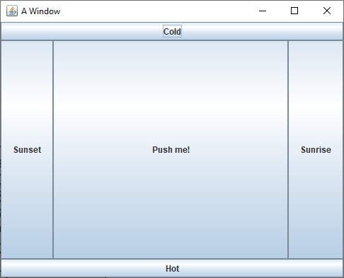
Adding to different parts of a JFrame
By default, a JFrame uses a layout manager called the BorderLayout that has five region
Calling the simplest add() method adds a widget to the center, which stretches to take up all available space
You can specify that you're adding to:
  BorderLayout.CENTER
  BorderLayout.NORTH
  BorderLayout.SOUTH
  BorderLayout.EAST
  BorderLayout.WEST
JButton centerButton = new JButton("Push me!");
frame.add(centerButton, BorderLayout.CENTER);
JButton northButton = new JButton("Cold");
frame.add(northButton, BorderLayout.NORTH);
JButton southButton = new JButton("Hot");
frame.add(southButton, BorderLayout.SOUTH);
JButton eastButton = new JButton("Sunrise");
frame.add(eastButton, BorderLayout.EAST);
JButton westButton = new JButton("Sunset");
frame.add(westButton, BorderLayout.WEST);

Slide 38
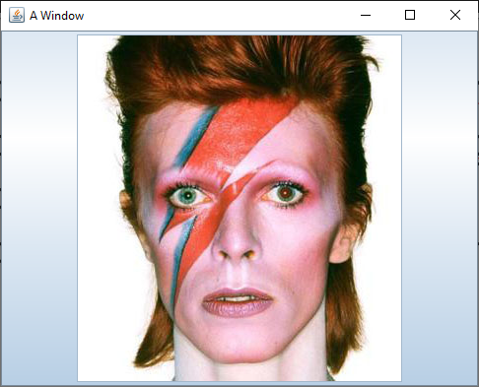
Displaying an icon on a JButton
You can also make a JButton with an image instead of text
To do so, you create an ImageIcon and pass that to the constructor of the JButton
You'll need the path to an image
JButton bowieButton = new JButton(new ImageIcon("bowie.jpg"));
frame.add(bowieButton, BorderLayout.CENTER);

Slide 39
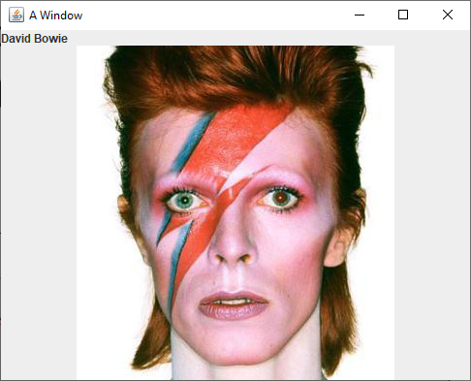
JLabel
A JLabel is like a button you can't click
Its constructors work just like the JButton ones
It allows you to display text or an image
JLabel nameLabel = new JLabel("David Bowie");
JLabel bowieLabel = new JLabel(new ImageIcon("bowie.jpg"));
frame.add(nameLabel, BorderLayout.NORTH);
frame.add(bowieLabel, BorderLayout.CENTER);

Slide 40
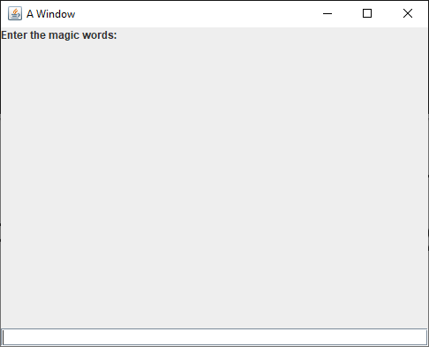
JTextField
A JTextField allows a user to enter a (short) amount of text
Usually, you'll need a JLabel to tell the person what they should enter
The example is ugly because the JLabel and the JTextField don't fill the 500 x 400 JFrame
JLabel messageLabel = new JLabel("Enter the magic words:");
JTextField magicField = new JTextField();
frame.add(messageLabel, BorderLayout.NORTH);
frame.add(magicField, BorderLayout.SOUTH);

Slide 41
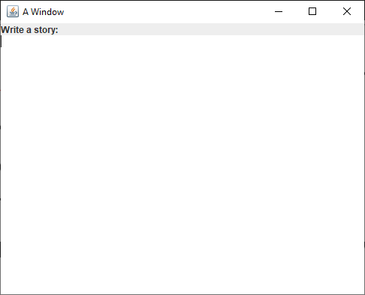
JTextArea
A JTextField is for entering small pieces of information
  Name
  Address
  Telephone number
For larger texts, we can use a JTextArea
JLabel storyLabel = new JLabel("Write a story:");
JTextArea storyArea = new JTextArea();
frame.add(storyLabel, BorderLayout.NORTH);
frame.add(storyArea, BorderLayout.CENTER);

Slide 42
Layout Managers

Slide 43
Layout managers
When you add a widget to a JFrame (or to a JPanel), its layout manager determines how it will be arranged
There are lots of layout managers, but it's worth mentioning four:
  BorderLayout
  GridLayout
  FlowLayout
  BoxLayout
We won't talk about BoxLayout, but you should look it up
BoxLayout makes it easy to arrange widgets in a horizontal or vertical line, with different amount of spacing between widgets

Slide 44
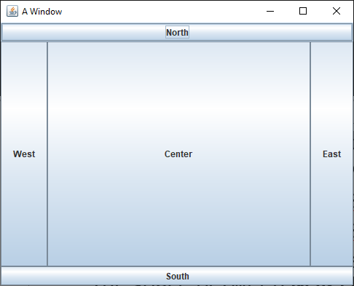
BorderLayout
BorderLayout is the default layout for JFrame
When you add widgets, you can specify the location as one of five regions:
  BorderLayout.NORTH stretches the width of the container on the top
  BorderLayout.SOUTH stretches the width of the container on the bottom
  BorderLayout.EAST sits on the right of the container, stretching to fill all the space between NORTH and SOUTH
  BorderLayout.WEST sits on the left of the container, stretching to fill all the space between NORTH and SOUTH
  BorderLayout.CENTER sits in the middle of the container and stretches to fill all available space
If you don't specify where you're adding a widget, it adds to CENTER
If you add more than one widget to a region, the new one replaces the old
Unused regions disappear

Slide 45
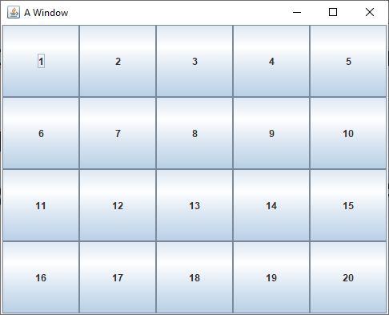
GridLayout
GridLayout allows you to create a grid with a specific number of rows and columns
All the cells in the grid are the same size
As you add widgets, they fill each row
frame.setLayout(new GridLayout(4, 5));
for (int row = 0; row < 4; ++row) {
for (int column = 0; column < 5; ++column) {
frame.add(new JButton("" + (row * 5 + column + 1)));
}
}

Slide 46
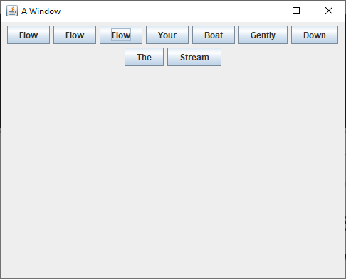
FlowLayout
FlowLayout is the default layout manager for JPanel
Widgets are arranged in centered rows in FlowLayout
If you keep adding widgets to a FlowLayout, they'll fill the current row until there's no more room
Then, they'll flow onto the next row
It's ugly but easy to use
frame.setLayout(new FlowLayout());
frame.add(new JButton("Flow"));
frame.add(new JButton("Flow"));
frame.add(new JButton("Flow"));
frame.add(new JButton("Your"));
frame.add(new JButton("Boat"));
frame.add(new JButton("Gently"));
frame.add(new JButton("Down"));
frame.add(new JButton("The"));
frame.add(new JButton("Stream"));

Slide 47
JPanel
A JPanel is an invisible container that:
  Acts like a widget in that you can add it to a JFrame (or another JPanel)
  Can hold other widgets
  Can have its layout customized with a layout manager
What if you have a BorderLayout and you want the EAST region to contain widgets arranged with a GridLayout?
Easy: you create a JPanel, set its layout manager to GridLayout, add it to the EAST region, then add widgets to the JPanel

Slide 48
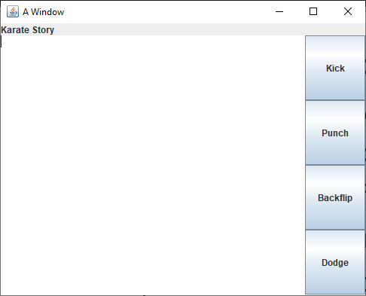
Complicated layouts
For complicated layouts
  Sketch out what you want it to look like
  Use BorderLayouts to give components a spatial relationship
  Nest JPanels inside of JPanels (inside of JPanels…) if you need to
  Use GridLayouts whenever you want to have a grid
  Be patient: it's hard to get it right the first time
JPanel buttonPanel = new JPanel(new GridLayout(4,1));
buttonPanel.add(new JButton("Kick"));
buttonPanel.add(new JButton("Punch"));
buttonPanel.add(new JButton("Backflip"));
buttonPanel.add(new JButton("Dodge"));
frame.add(buttonPanel, BorderLayout.EAST);
frame.add(new JLabel("Karate Story"), BorderLayout.NORTH);
frame.add(new JTextArea(), BorderLayout.CENTER);

Slide 49
Action Listeners

Slide 50
Making buttons do things
We have added JButtons to JFrames, but those buttons don't do anything
When clicked, a JButton fires an event
We need to add an action listener to do something when that event happens
A CLI program runs through loops, calls methods, and makes decisions until it runs out of stuff to do
GUIs usually have this event-based programming model
They sit there, waiting for events to cause methods to get called

Slide 51
ActionListener interface
What can listen for a JButton to click?
Any object that implements ActionListener
ActionListener is an interface like any other with a single abstract method in it:
void actionPerformed(ActionEvent e);
We need to write a class with such a method
We will rarely need to worry about the ActionEvent object
But it does have a getSource() method that will give us the Object (often a JButton) that fired the event

Slide 52
Adding an action listener
Using an anonymous inner class, we can make an ActionListener object right when we need it, for a button
It's ugly, but it works
JButton button = new JButton("Push me!");
button.addActionListener(new ActionListener() {
public void actionPerformed(ActionEvent e) {
button.setText("Ouch!"); // arbitrary code
}
}); // ugly: parenthesis for end of method call

Slide 53
Things you might do in an action listener
Call arbitrary methods
setText() sets the text on many widgets
getText() gets the text from widgets so you can do something with it
Both setText() and getText() apply to:
  JButton
  JLabel
  JTextField
  JTextArea
setIcon() sets the icon on many widgets
  JButton
  JLabel
setEnabled() can be used to enable and disable buttons

Slide 54
Java 8 style
Before Java 8, we only had two choices:
  Make a whole class that implements ActionListener and might have to do different actions based on which button fired the event
  Make a separate anonymous inner class for every single button, each doing the action for that button
Java 8 adds something called lambdas which actually make anonymous inner classes too, but the syntax is much nicer
Java 8 style:
JButton button = new JButton("Push me!");
button.addActionListener(e -> button.setText("Ouch!"));

Slide 55
More on Java 8 style
An interface with only a single method in it (like ActionListener) is called a functional interface
Java 8 lets us instantiate functional interface by filling out the method:
(Type1 arg1, Type2 arg2, …) -> { /* method body */ }
But if it's possible for the compiler to infer the argument types, they don't have to be written
If you only have a single argument, you don't need parentheses
And if you only have a single line in your method body, you don't need braces
Multi-line example:
JButton button = new JButton("Push me!");
button.addActionListener(e -> {
button.setText("Ouch!");
button.setEnabled(false);
});

Slide 56
Upcoming

Slide 57
Next time…
Visual design principles
Software engineering design

Slide 58
Reminders
Read Chapter 7: Software Engineering Design for Wednesday
Keep working on the draft of Project 2
  Due Friday of next week

